Slide 1
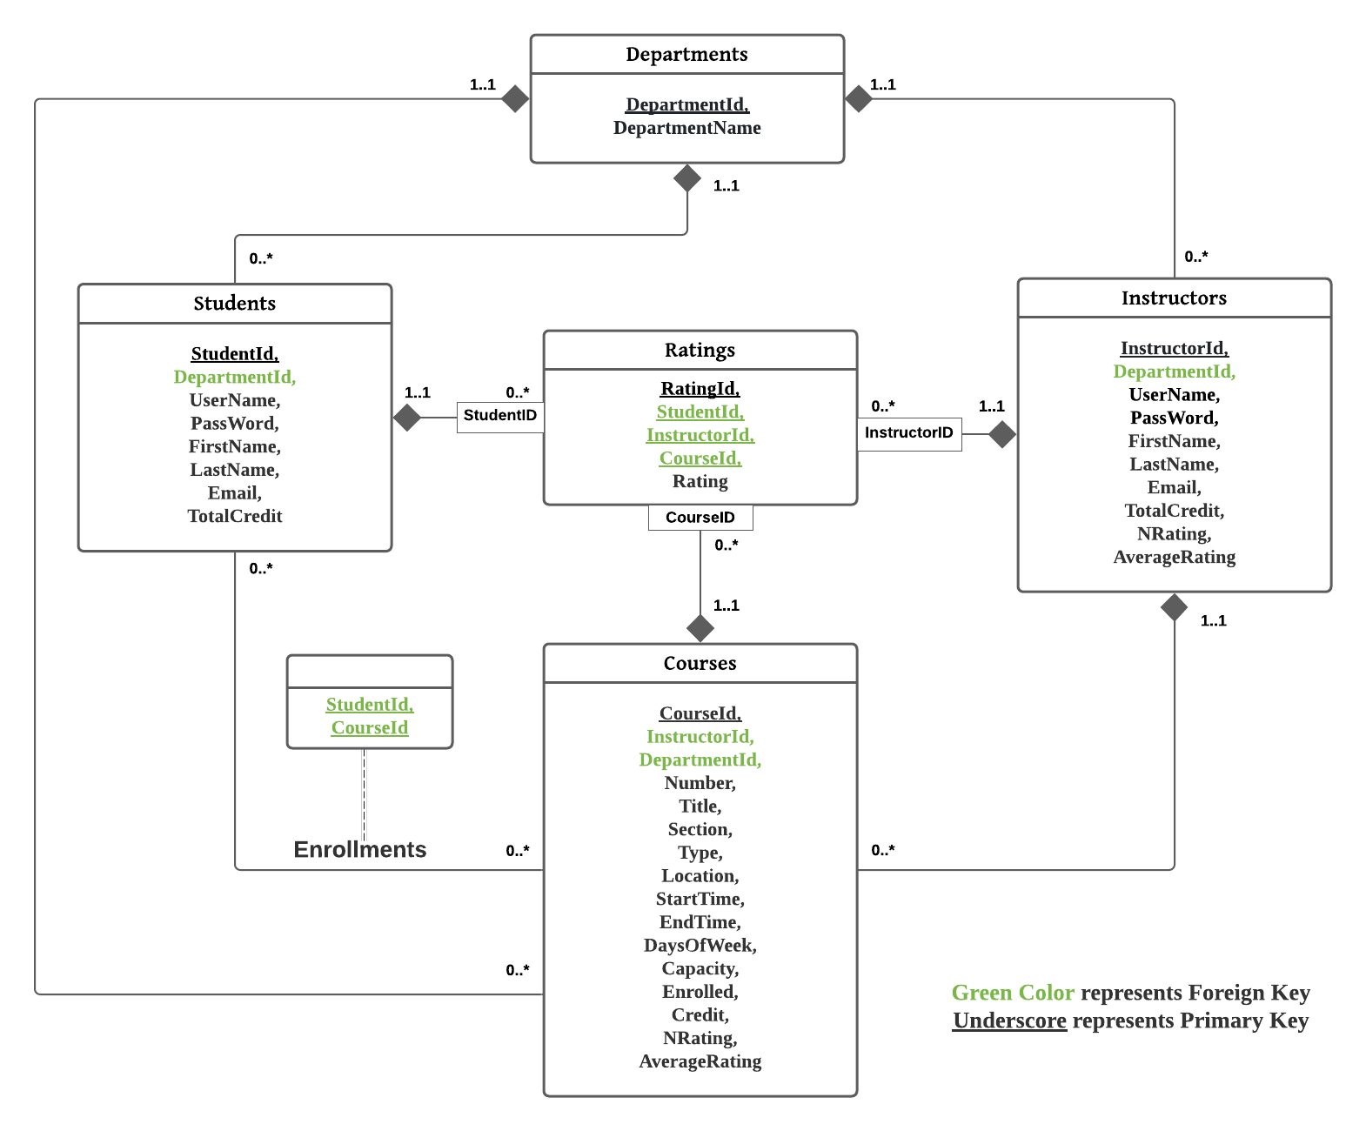

Slide 2
Course Enrollment & Management System
Everyone
See all the available courses and all registered instructors.
Search for certain course(s) or instructor(s) based on keywords.
Unregistered User
Register as either a student (normal) user or instructor user.
Student users can give a rating to the course(s) that he/she takes. We record the ratings and will rank all the departments according to their average ratings.

Slide 3
Course Enrollment & Management System
Student (Normal) User
Enroll course(s).
Drop enrolled course(s).
Rate enrolled course(s) and the corresponding instructor.
Registered User
Instructor User
Create course(s).
Cancel course(s).
Edit course(s) that he/she created.
Both allowed to withdraw himself/herself from the system.

Slide 4
Course Enrollment & Management System
Frontend
React.js (JavaScript)
Technical Stacks:
Backend
Django Rest Framework (Python)
Database
SQL (MySQL)

